Slide 1
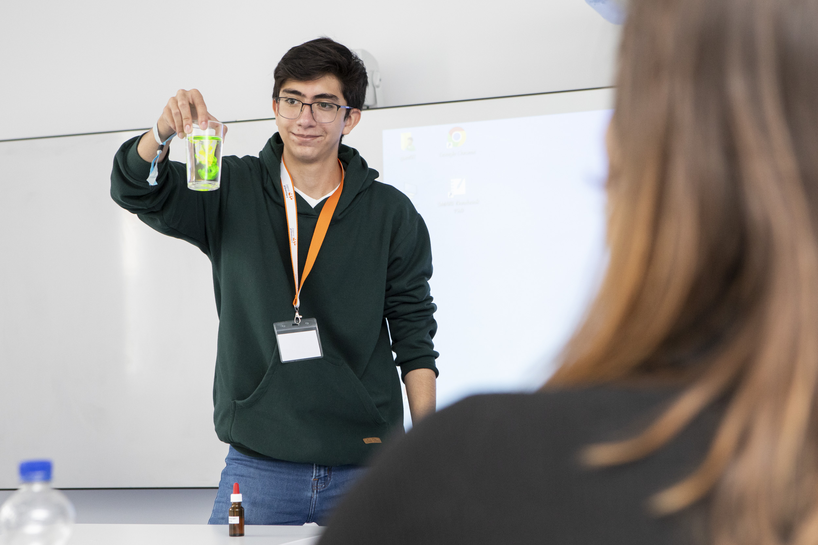



Bilder & Situationen

Slide 2
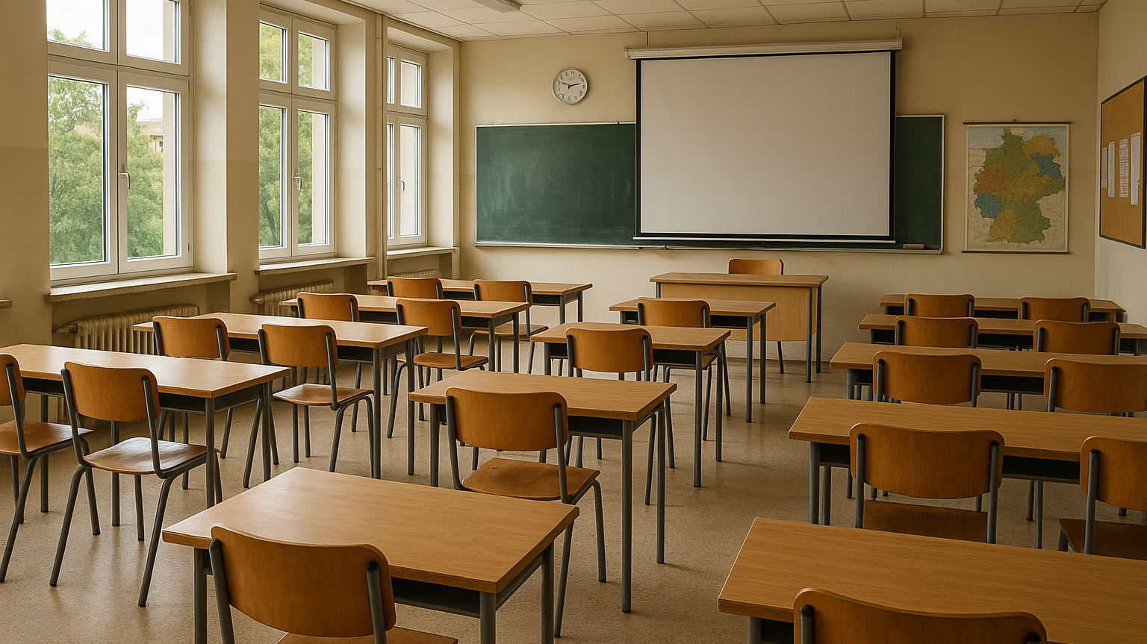
Notes:
Prompt für Sora:
Photorealistic image of a typical German classroom, with rows of wooden desks and chairs facing the front, a blackboard and projector screen, daylight coming from large side windows, familiar school environment in Germany.

Slide 3
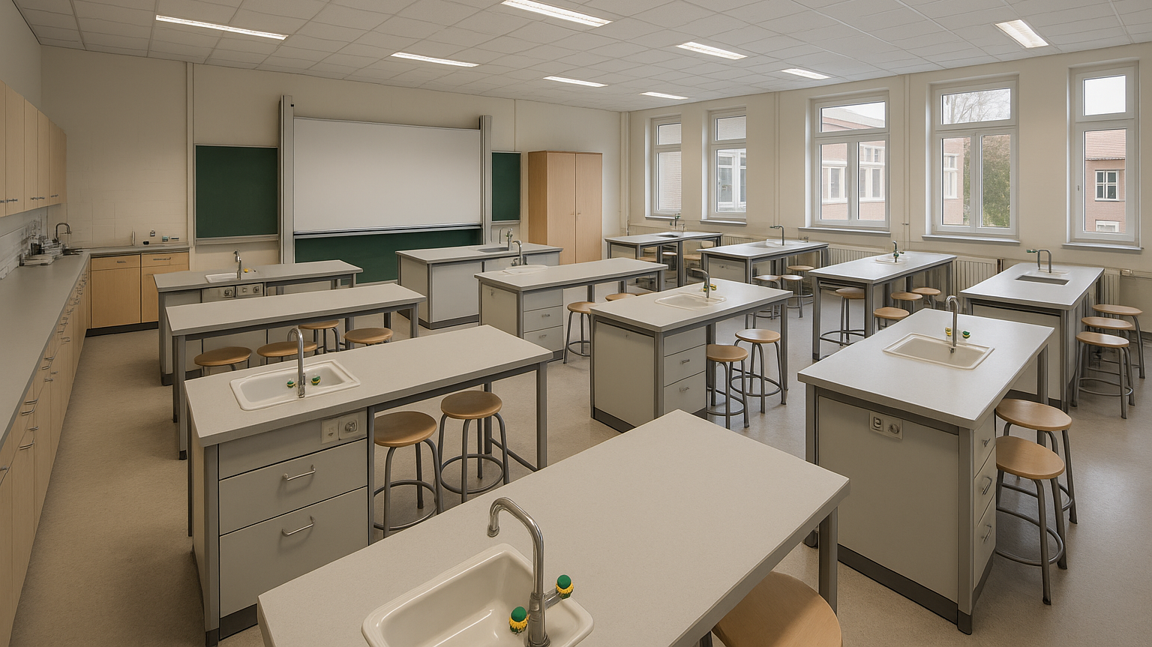
Notes:
Prompt für Sora:
Photorealistic image of a typical German STEM classroom with lab benches and stools, a large whiteboard at the front, bright ceiling lights illuminating the room, modern furniture and equipment, designed in a style familiar to German schools, completely empty without people.

Slide 4
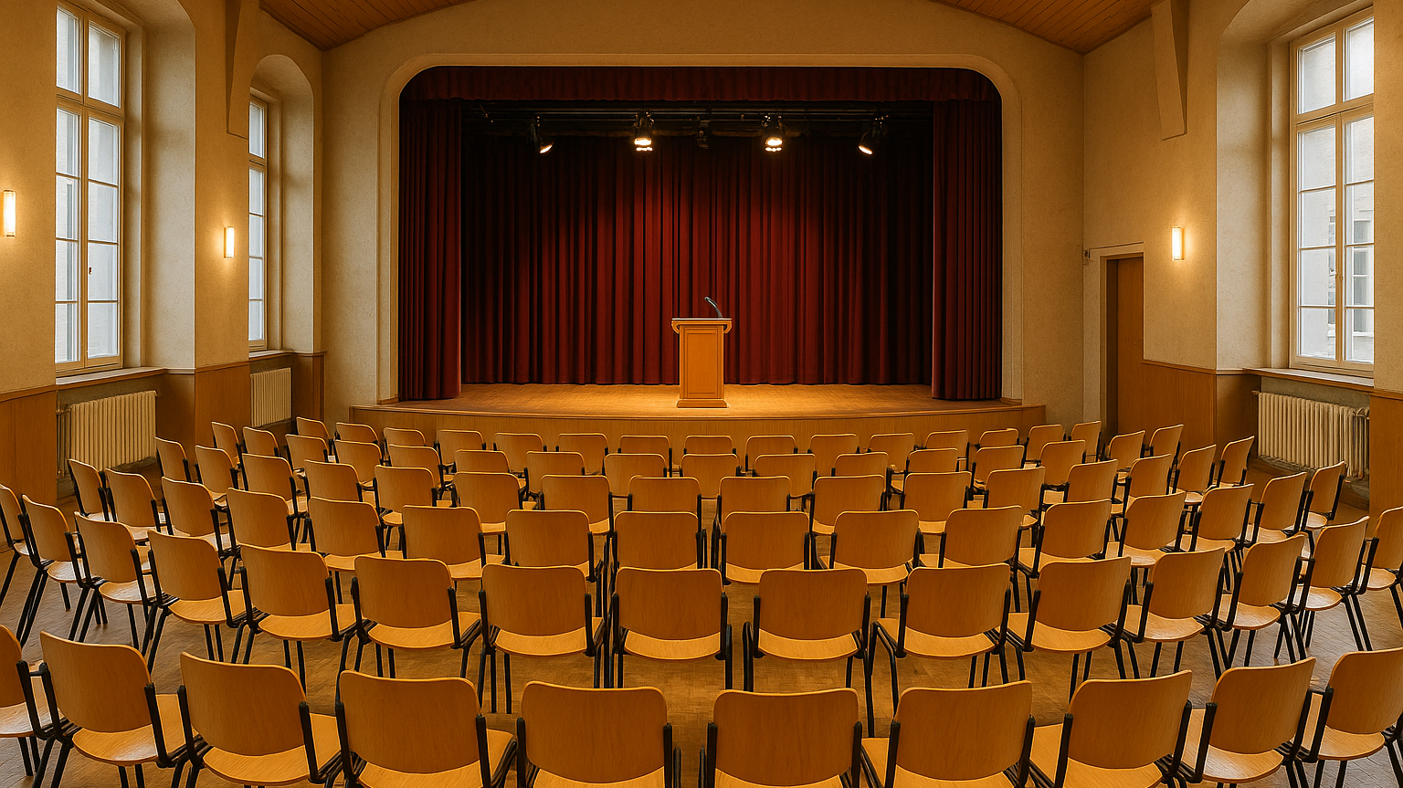
Notes:
Prompt für Sora:
Photorealistic image of a typical German school auditorium with a stage and podium, rows of chairs arranged in a semicircle facing the stage, stage lights highlighting the presenter’s position, there is no audience, but there are several empty seating rows, high ceiling and warm lighting, characteristic of German school buildings.

Slide 5
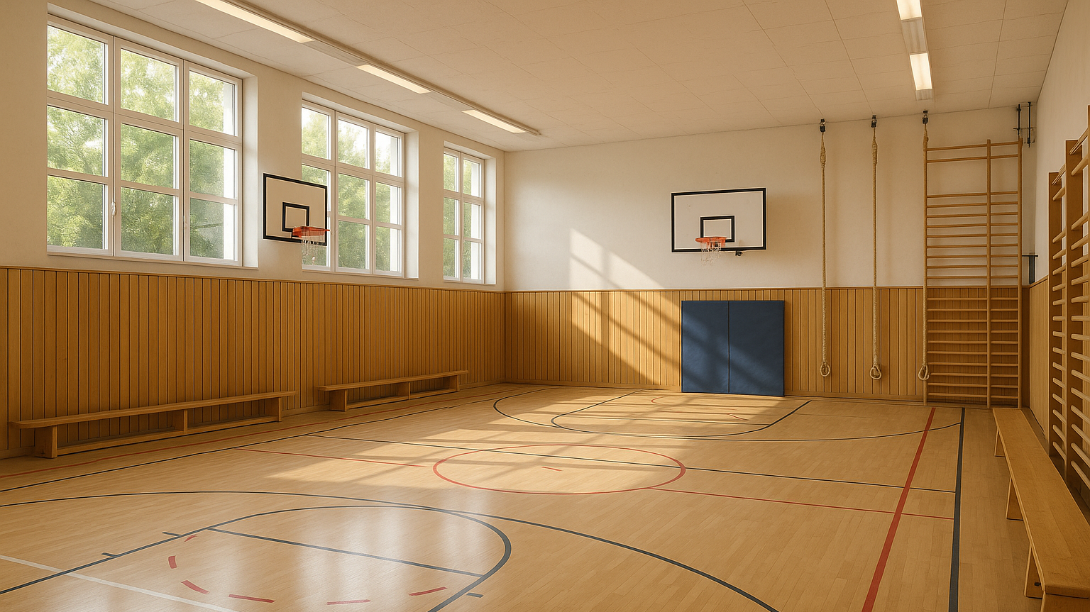
Notes:
Prompt für Sora:
Photorealistic image of a typical German school sports hall, empty, with wooden flooring, basketball hoops, climbing ropes on the walls, and benches at the sides, bright daylight coming from large windows, a familiar environment for student presentations in Germany.

Slide 6
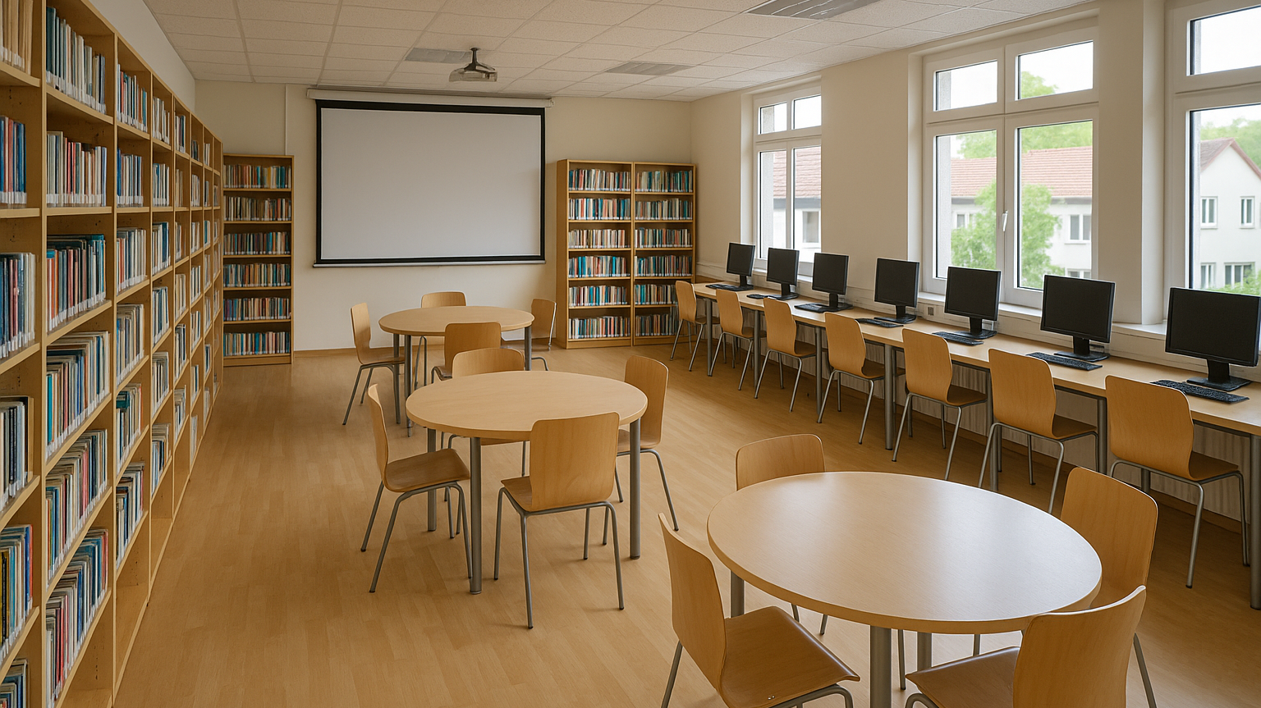
Notes:
Prompt für Sora:
Photorealistic image of a typical German school library and media room, empty, with bookshelves, computer stations, and a projector screen at the front, modern furniture and large windows providing natural light, designed in a style familiar to German schools.

Slide 7
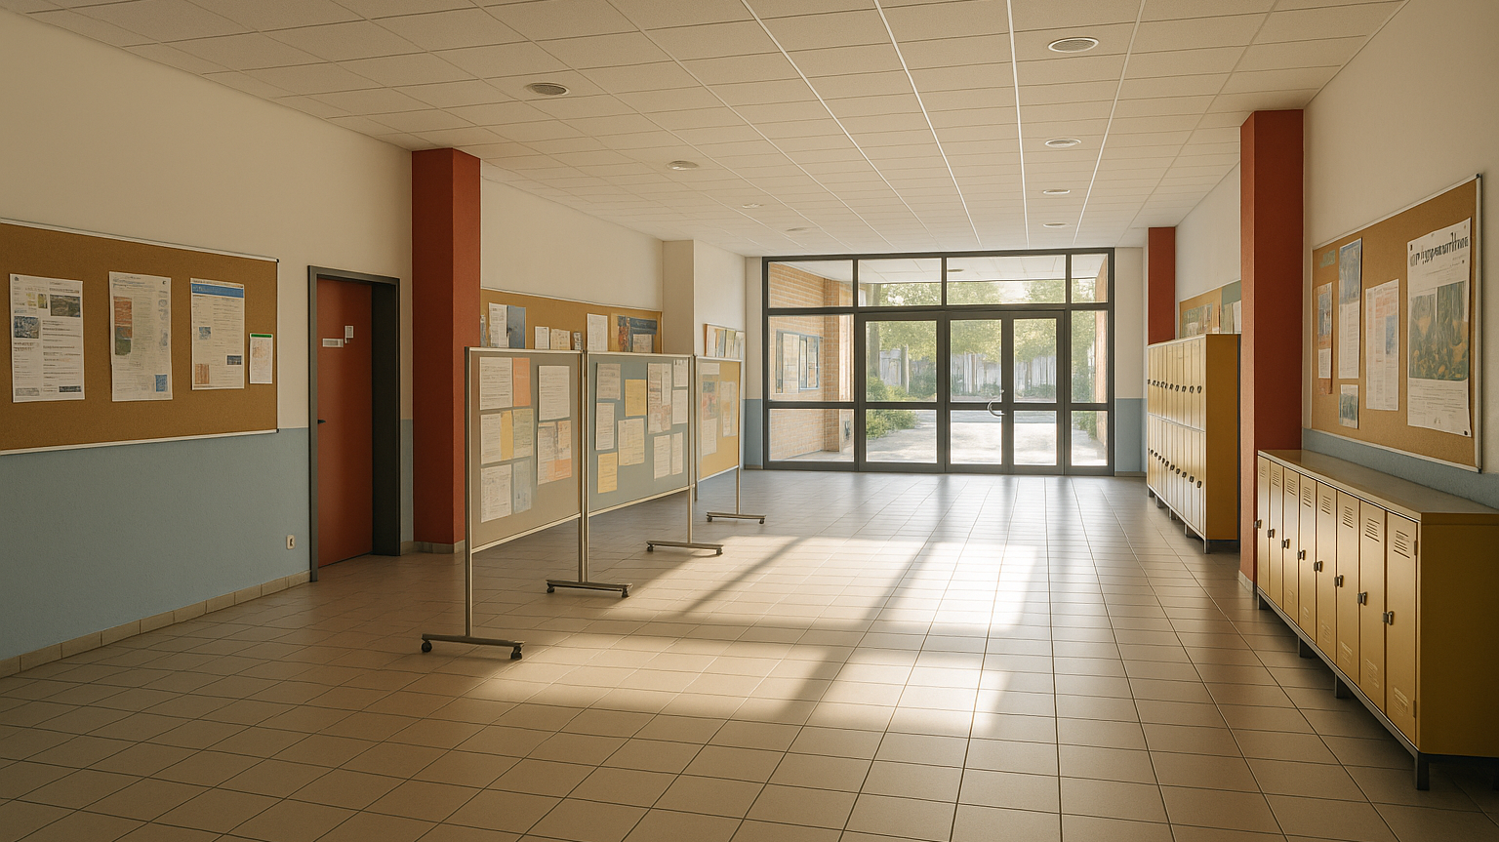
Notes:
Prompt für Sora:
Photorealistic image of a typical German school hallway and foyer, empty, with display boards, posters on the walls, lockers, and wide open space suitable for poster presentations, daylight streaming in through glass doors, interior design familiar in German schools.

Slide 8
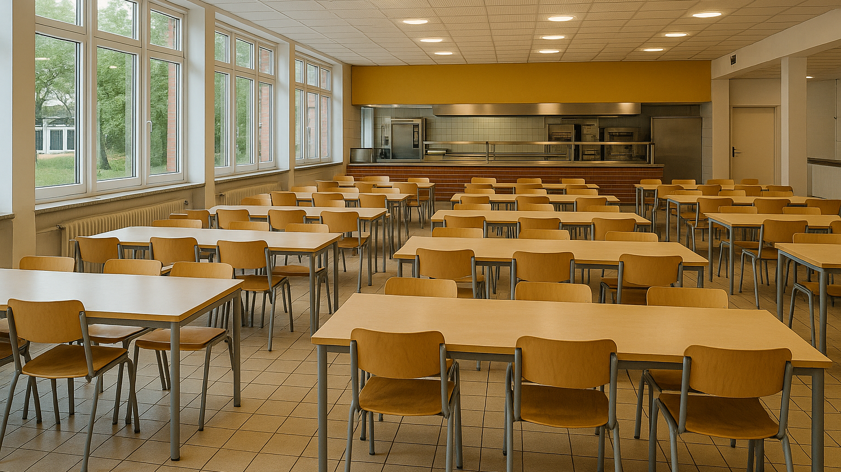
Notes:
Prompt für Sora:
Photorealistic image of a typical German school cafeteria, empty, with of tables and chairs, serving counter in the background, bright lighting and large windows, a space often used for project presentations and events, designed in a style familiar to German schools.

Slide 9
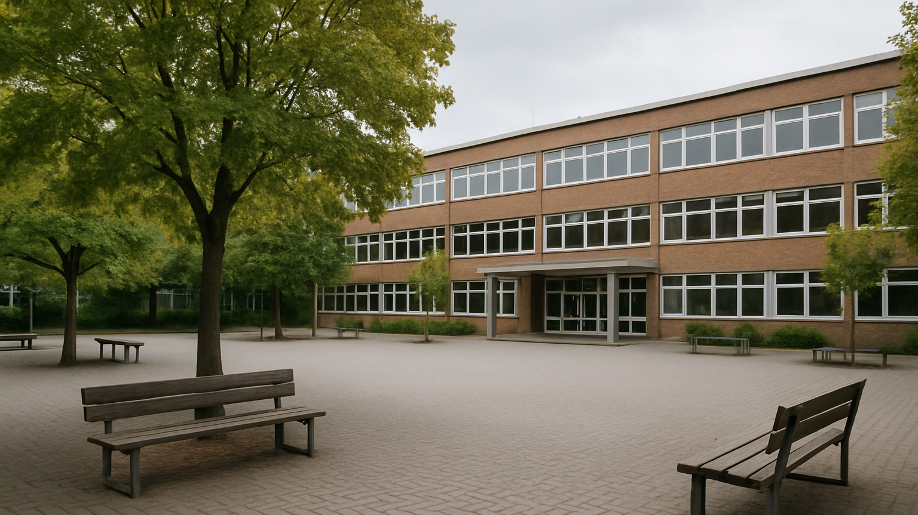
Notes:
Prompt für Sora:
Photorealistic image of a typical German schoolyard, empty, with paved ground, some benches, trees, and the school building visible in the background, a familiar outdoor environment in German schools where presentations or projects can take place.

Slide 10
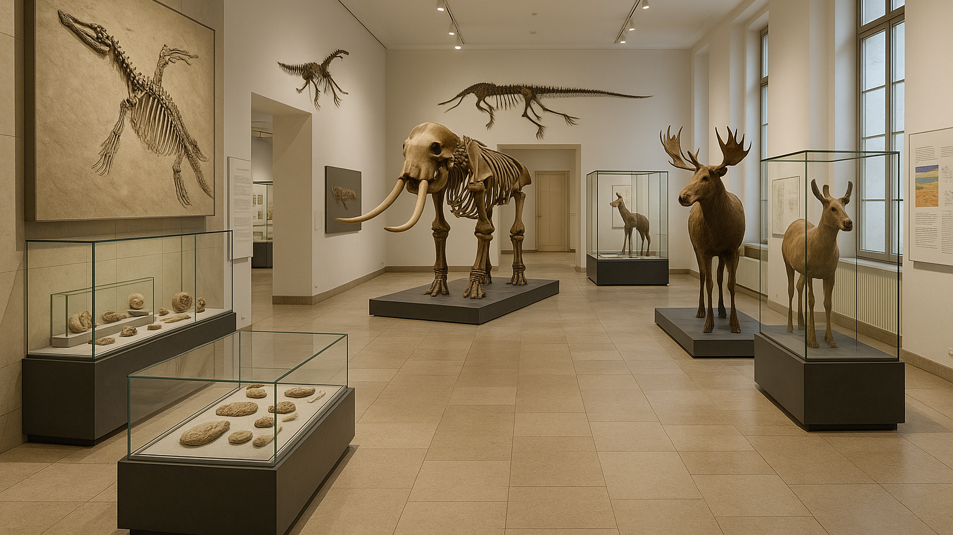
Notes:
Prompt für Sora:
Photorealistic image of a typical German natural history museum interior, empty, with large exhibition displays such as fossils, skeletons, or taxidermy animals, glass cases and informative panels on the walls, bright neutral lighting, modern yet familiar architecture, designed in a style recognizable to German students on excursions.

Slide 11


Hier ist Raum für weitere Bildideen

Slide 12
Bildquellen; alle mit KI (SORA) erstellt
Prompts:
Folie 2: Photorealistic image of a typical German classroom, with rows of wooden desks and chairs facing the front, a blackboard and projector screen, daylight coming from large side windows, familiar school environment in Germany.
Folie 3: Photorealistic image of a typical German STEM classroom with lab benches and stools, a large whiteboard at the front, bright ceiling lights illuminating the room, modern furniture and equipment, designed in a style familiar to German schools, completely empty without people.
Folie 4: Photorealistic image of a typical German school auditorium with a stage and podium, rows of chairs arranged in a semicircle facing the stage, stage lights highlighting the presenter’s position, there is no audience, but there are several empty seating rows, high ceiling and warm lighting, characteristic of German school buildings.
Folie 5: Photorealistic image of a typical German school sports hall, empty, with wooden flooring, basketball hoops, climbing ropes on the walls, and benches at the sides, bright daylight coming from large windows, a familiar environment for student presentations in Germany.
Folie 6: Photorealistic image of a typical German school library and media room, empty, with bookshelves, computer stations, and a projector screen at the front, modern furniture and large windows providing natural light, designed in a style familiar to German schools.
Folie 7: Photorealistic image of a typical German school hallway and foyer, empty, with display boards, posters on the walls, lockers, and wide open space suitable for poster presentations, daylight streaming in through glass doors, interior design familiar in German schools.

Slide 13
Bildquellen; alle mit KI (SORA) erstellt
Prompts:
Folie 8: Photorealistic image of a typical German school cafeteria, empty, with of tables and chairs, serving counter in the background, bright lighting and large windows, a space often used for project presentations and events, designed in a style familiar to German schools.
Folie 9: Photorealistic image of a typical German schoolyard, empty, with paved ground, some benches, trees, and the school building visible in the background, a familiar outdoor environment in German schools where presentations or projects can take place.
Folie 10: Photorealistic image of a typical German natural history museum interior, empty, with large exhibition displays such as fossils, skeletons, or taxidermy animals, glass cases and informative panels on the walls, bright neutral lighting, modern yet familiar architecture, designed in a style recognizable to German students on excursions.

