Slide 1
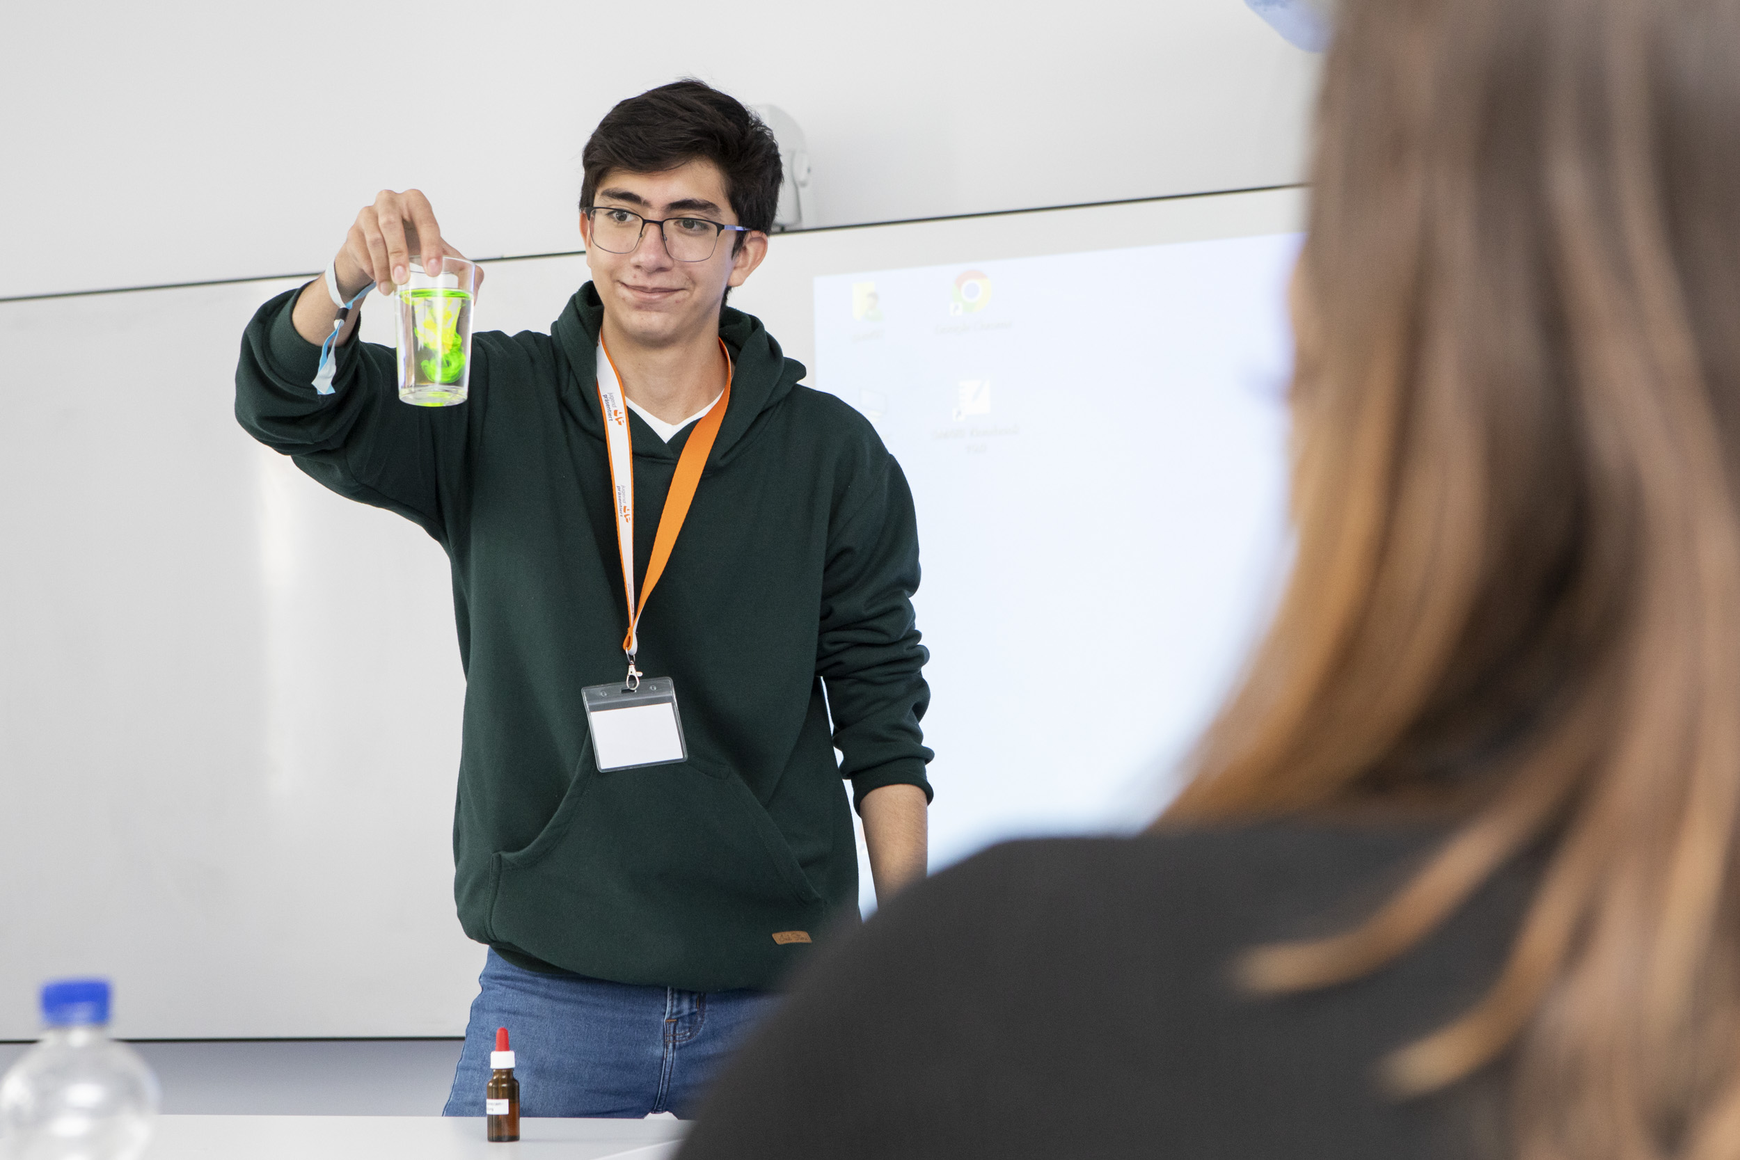



Bilder & Situationen

Slide 2
In welcher Situation befinden sich die Menschen?
In welcher Stimmung befinden sich die Personen möglicherweise?
Wie könnte man ihre Aufmerksamkeit gewinnen oder halten?

Slide 3
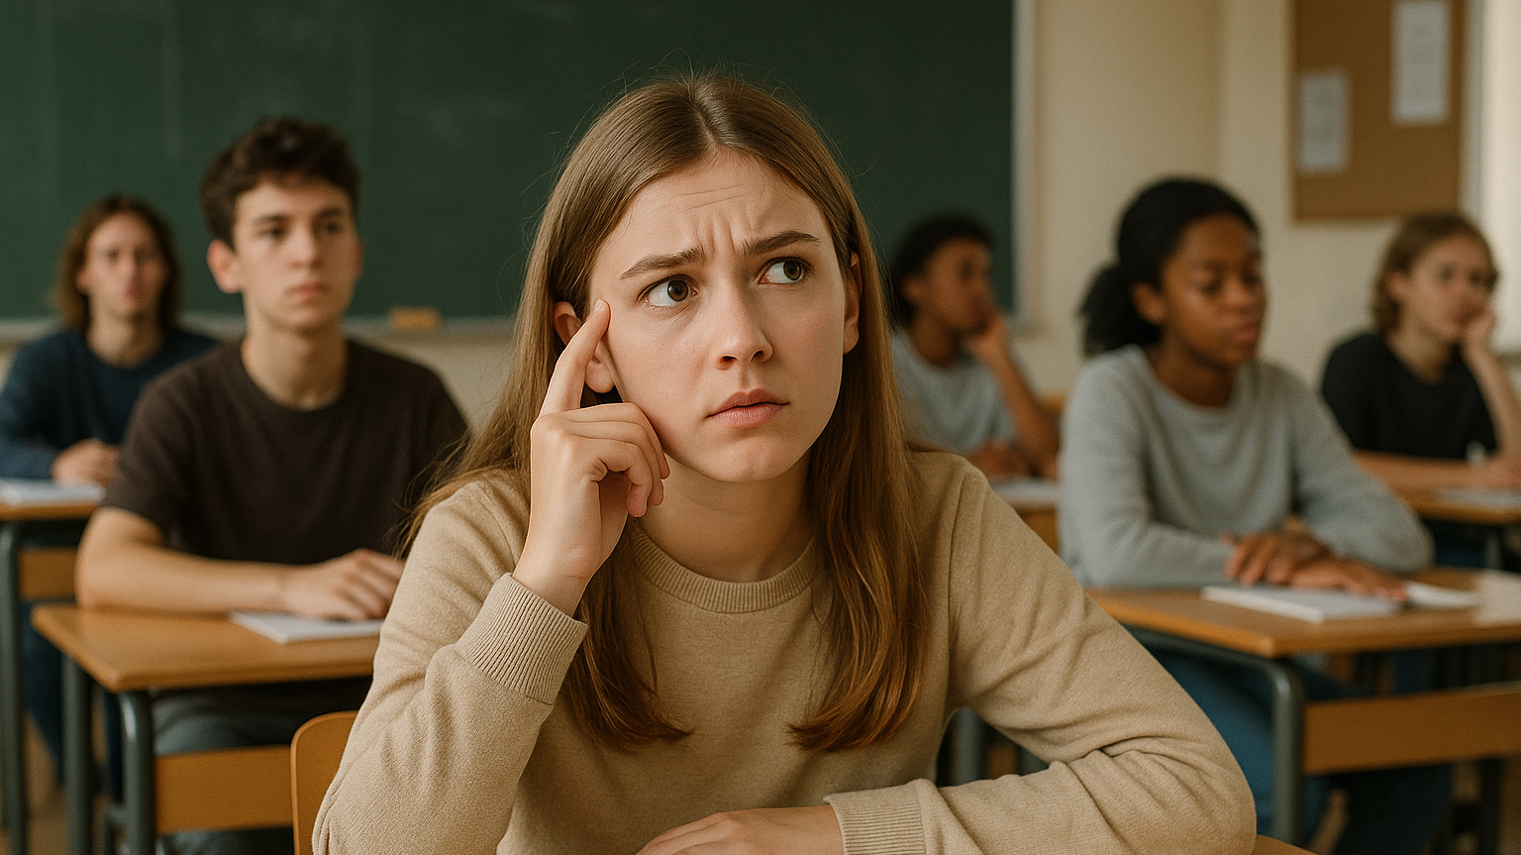
Notes:
A girl student sitting in a typical German classroom at a simple wooden desk with metal legs, as commonly found in German schools. She appears to be diligently listen to a presentation, but she also seems to have questions or is unsure. In the background, typical classroom details such as a chalkboard and additional desks are visible. o the desks, there are sitting other students, some seem to listen, some seem otherwise distracted. Realistic style.

Slide 4
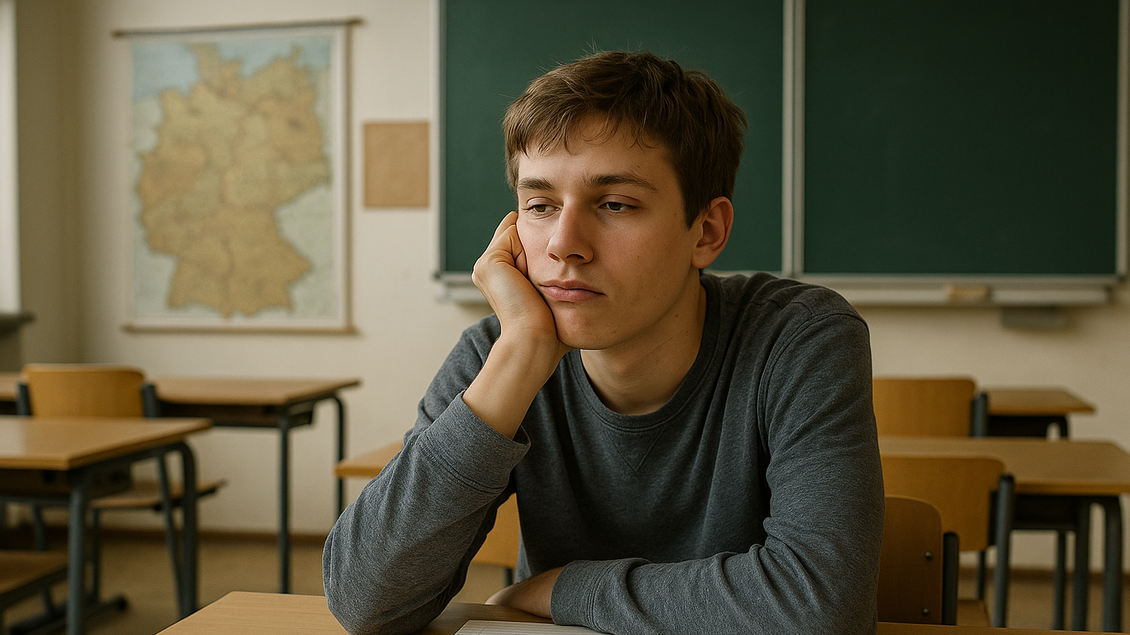
Notes:
A student sitting in a typical German classroom at a simple wooden desk with metal legs, as commonly found in German schools. He appears to be listening to a presentation, but looks visibly bored: his gaze is directed forward yet dull and uninterested, his head resting slightly on one hand, and his posture is slouched. In the background, typical classroom details such as a chalkboard and additional desks are visible. Realistic style.

Slide 5
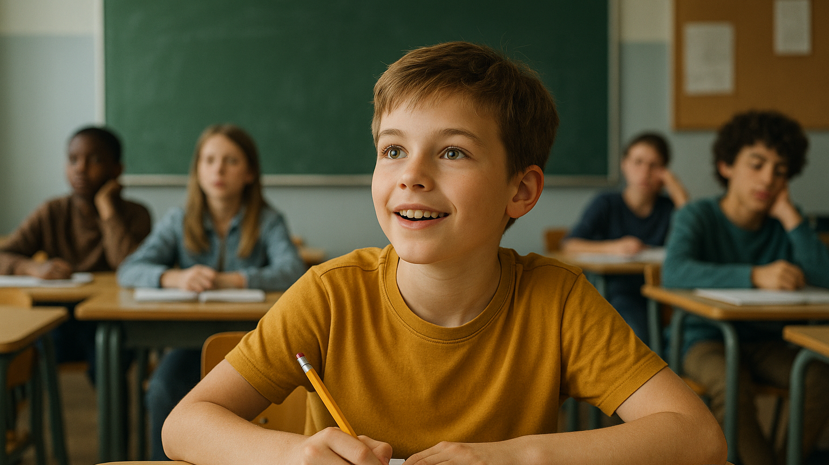
Notes:
A boy student sitting in a typical German classroom at a simple wooden desk with metal legs, as commonly found in German schools. he ist diligently listening to a presentation, he seems enthusiastic and has a pencil in his hand, seeminglyto write down interesting stuff: his gaze is open. In the background, typical classroom details such as a chalkboard and additional desks are visible. on the desks, there are sitting other students, some seem to listen, some seem otherwise distracted. Realistic style.

Slide 6
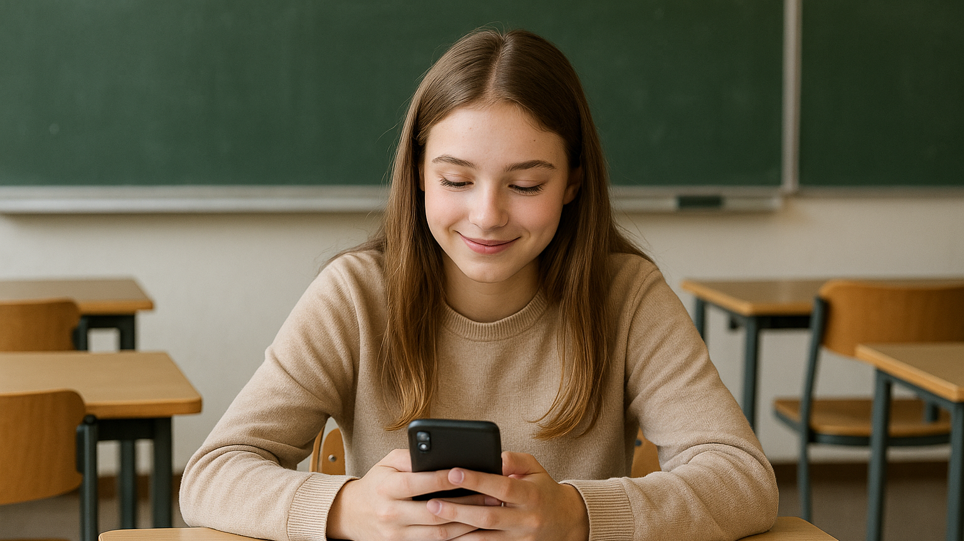
Notes:
A girl student sitting in a typical German classroom at a simple wooden desk with metal legs, as commonly found in German schools. She appears to be listening to a presentation, but also seems to be distracted by her smarthpone: her gaze is directed to the phne, she is smiling slightly, . In the background, typical classroom details such as a chalkboard and additional desks are visible. Realistic style.

Slide 7
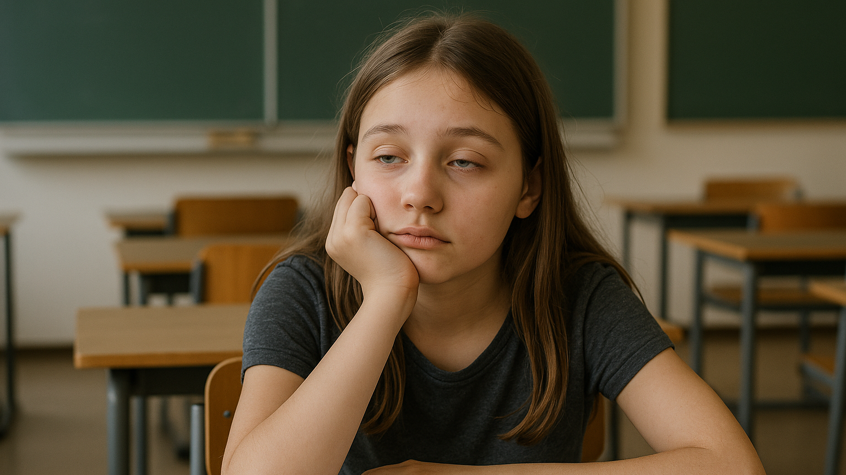
Notes:
A girl student sitting in a typical German classroom at a simple wooden desk with metal legs, as commonly found in German schools. She appears to be trying to listen to a presentation, but also seems to be very tired: her gaze is sleepy. In the background, typical classroom details such as a chalkboard and additional desks are visible. Realistic style.

Slide 8
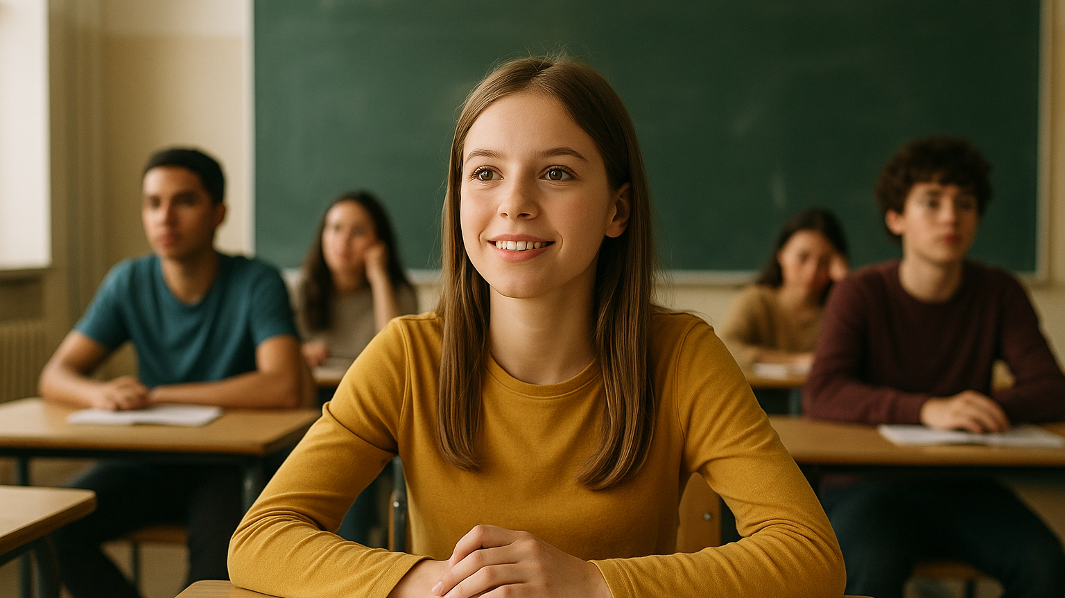
Notes:
A girl student sitting in a typical German classroom at a simple wooden desk with metal legs, as commonly found in German schools. She appears to be diligently listen to a presentation, and she also seems to be motivated. In the background, typical classroom details such as a chalkboard and additional desks are visible. o the desks, there are sitting other students, some seem to listen, some seem otherwise distracted. Realistic style.

Slide 9
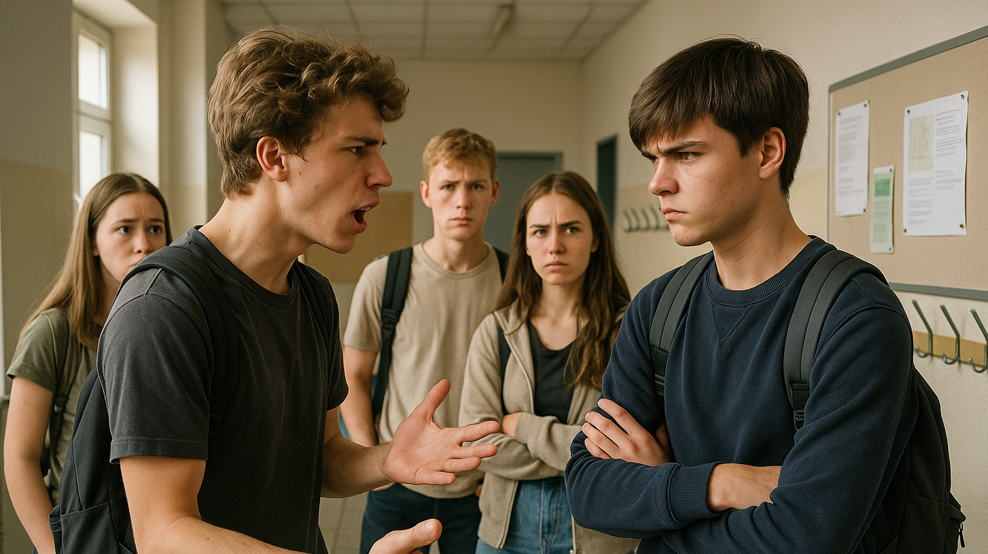
Notes:
A photorealistic image of two 16-year-old German students arguing emotionally in a typical German school hallway. One is gesturing with frustration, the other has crossed arms and a tense expression. A few other teenagers (also around 16) stand nearby, watching the scene with mixed reactions – concern, curiosity, irritation. The hallway has plain beige or light grey walls, tiled flooring, coat hooks on the wall, simple noticeboards with some posters or worksheets pinned. There are no lockers, no flags, no visible school branding. Natural lighting from the windows, realistic shadows, documentary-style composition.

Slide 10
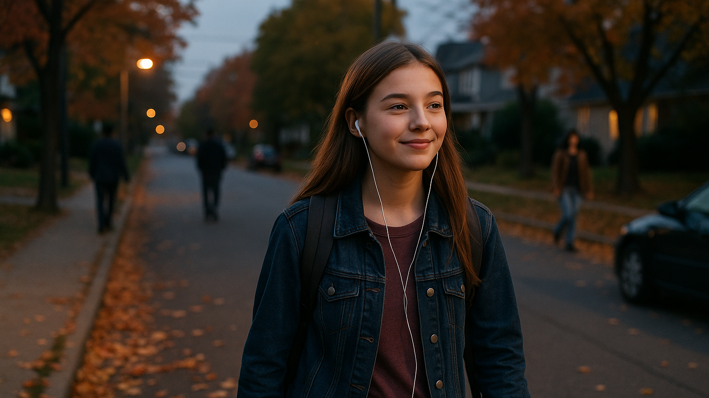
Notes:
A teenage girl (15) walking alone with a backpack through a suburban street at dusk, earphones in, slightly happy expression, autumn leaves on the sidewalk, realstic scenerie with other people also walking around.

Slide 11
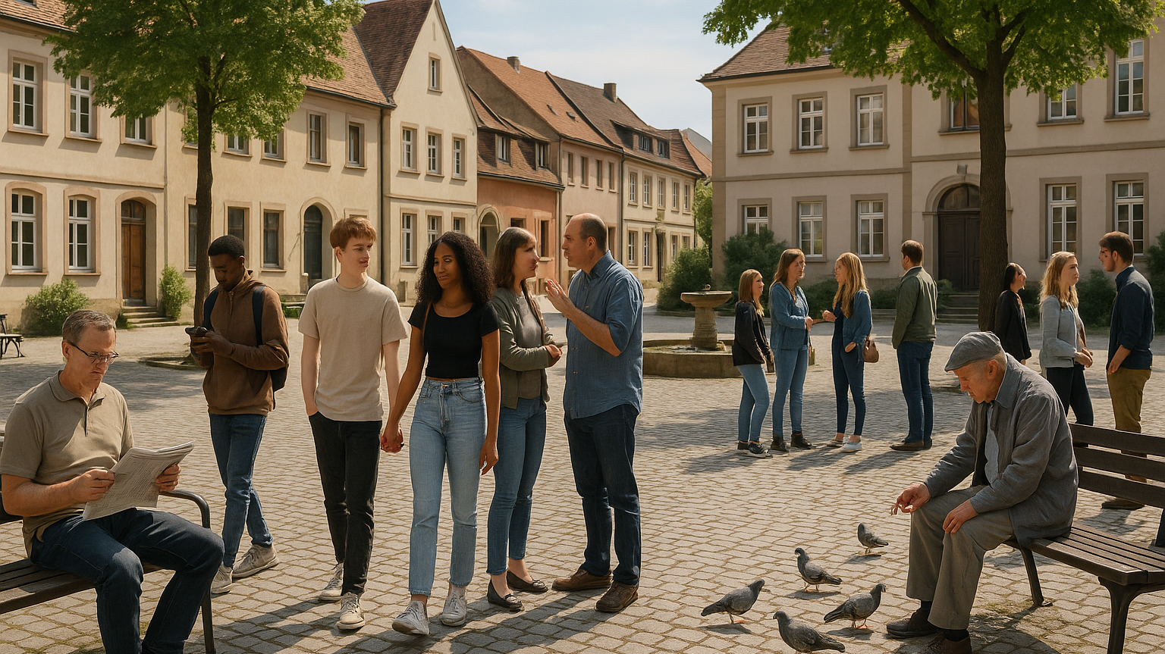
Notes:
A photorealistic image of a diverse group of people (teenagers, adults, seniors) on a typical German city square. The scene is full of natural, unspectacular everyday activity: one person is reading a newspaper on a bench, another one is looking at their smartphone while walking, a couple is arguing, two teenagers are walking hand in hand, an elderly man is feeding pigeons, a woman is pushing a stroller, some people are talking in pairs or small groups. The square features cobblestones, a modest fountain, simple wooden or metal benches, trees or small greenery around. Background architecture should include typical German townhouses or municipal buildings – no flags, no visible signage, no national symbols. Lighting should be even and natural, midday conditions, no dramatic atmosphere. Candid, unstaged composition.

Slide 12
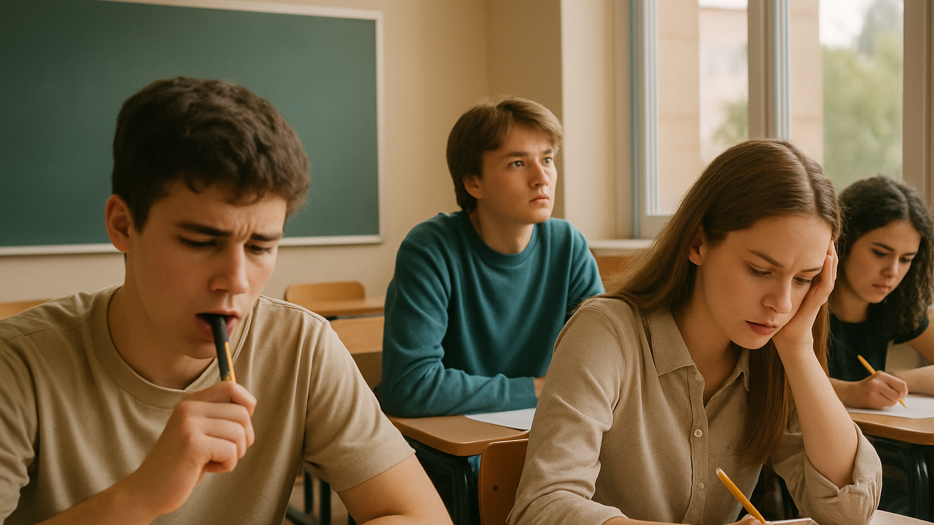
Notes:
A group of teenagers (14–17 years old) sitting at school desks, nervous and focused, one student biting a pen, another one staring out the window, light coming from classroom windows. Natural colors, realistic school setting, medium shot. In the background, typical classroom details such as a chalkboard and additional desks are visible.

Slide 13


Hier ist Raum für weitere
Bildideen

Slide 14
Bildquellen; alle mit KI (SORA) erstellt
Prompts:
Folie 3: A girl student sitting in a typical German classroom at a simple wooden desk with metal legs, as commonly found in German schools. She appears to be diligently listen to a presentation, but she also seems to have questions or is unsure. In the background, typical classroom details such as a chalkboard and additional desks are visible. o the desks, there are sitting other students, some seem to listen, some seem otherwise distracted. Realistic style.
Folie 4: A student sitting in a typical German classroom at a simple wooden desk with metal legs, as commonly found in German schools. He appears to be listening to a presentation, but looks visibly bored: his gaze is directed forward yet dull and uninterested, his head resting slightly on one hand, and his posture is slouched. In the background, typical classroom details such as a chalkboard and additional desks are visible. Realistic style.
Folie 5: A boy student sitting in a typical German classroom at a simple wooden desk with metal legs, as commonly found in German schools. he ist diligently listening to a presentation, he seems enthusiastic and has a pencil in his hand, seeminglyto write down interesting stuff: his gaze is open. In the background, typical classroom details such as a chalkboard and additional desks are visible. on the desks, there are sitting other students, some seem to listen, some seem otherwise distracted. Realistic style.

Slide 15
Bildquellen; alle mit KI (SORA) erstellt
Prompts:
Folie 6: A girl student sitting in a typical German classroom at a simple wooden desk with metal legs, as commonly found in German schools. She appears to be listening to a presentation, but also seems to be distracted by her smarthpone: her gaze is directed to the phne, she is smiling slightly, . In the background, typical classroom details such as a chalkboard and additional desks are visible. Realistic style.
Folie 7: A girl student sitting in a typical German classroom at a simple wooden desk with metal legs, as commonly found in German schools. She appears to be trying to listen to a presentation, but also seems to be very tired: her gaze is sleepy. In the background, typical classroom details such as a chalkboard and additional desks are visible. Realistic style.
Folie 8: A girl student sitting in a typical German classroom at a simple wooden desk with metal legs, as commonly found in German schools. She appears to be diligently listen to a presentation, and she also seems to be motivated. In the background, typical classroom details such as a chalkboard and additional desks are visible. on the desks, there are sitting other students, some seem to listen, some seem otherwise distracted. Realistic style.

Slide 16
Bildquellen; alle mit KI (SORA) erstellt
Prompts:
Folie 9: A photorealistic image of two 16-year-old German students arguing emotionally in a typical German school hallway. One is gesturing with frustration, the other has crossed arms and a tense expression. A few other teenagers (also around 16) stand nearby, watching the scene with mixed reactions – concern, curiosity, irritation. The hallway has plain beige or light grey walls, tiled flooring, coat hooks on the wall, simple noticeboards with some posters or worksheets pinned. There are no lockers, no flags, no visible school branding. Natural lighting from the windows, realistic shadows, documentary-style composition.
Folie 10: A teenage girl (15) walking alone with a backpack through a suburban street at dusk, earphones in, slightly happy expression, autumn leaves on the sidewalk, realstic scenerie with other people also walking around.
Folie 11: A photorealistic image of a diverse group of people (teenagers, adults, seniors) on a typical German city square. The scene is full of natural, unspectacular everyday activity: one person is reading a newspaper on a bench, another one is looking at their smartphone while walking, a couple is arguing, two teenagers are walking hand in hand, an elderly man is feeding pigeons, a woman is pushing a stroller, some people are talking in pairs or small groups. The square features cobblestones, a modest fountain, simple wooden or metal benches, trees or small greenery around. Background architecture should include typical German townhouses or municipal buildings – no flags, no visible signage, no national symbols. Lighting should be even and natural, midday conditions, no dramatic atmosphere. Candid, unstaged composition.

Slide 17
Bildquellen; alle mit KI (SORA) erstellt
Prompts:
Folie 12: A group of teenagers (14–17 years old) sitting at school desks, nervous and focused, one student biting a pen, another one staring out the window, light coming from classroom windows. Natural colors, realistic school setting, medium shot. In the background, typical classroom details such as a chalkboard and additional desks are visible.

