Slide 1
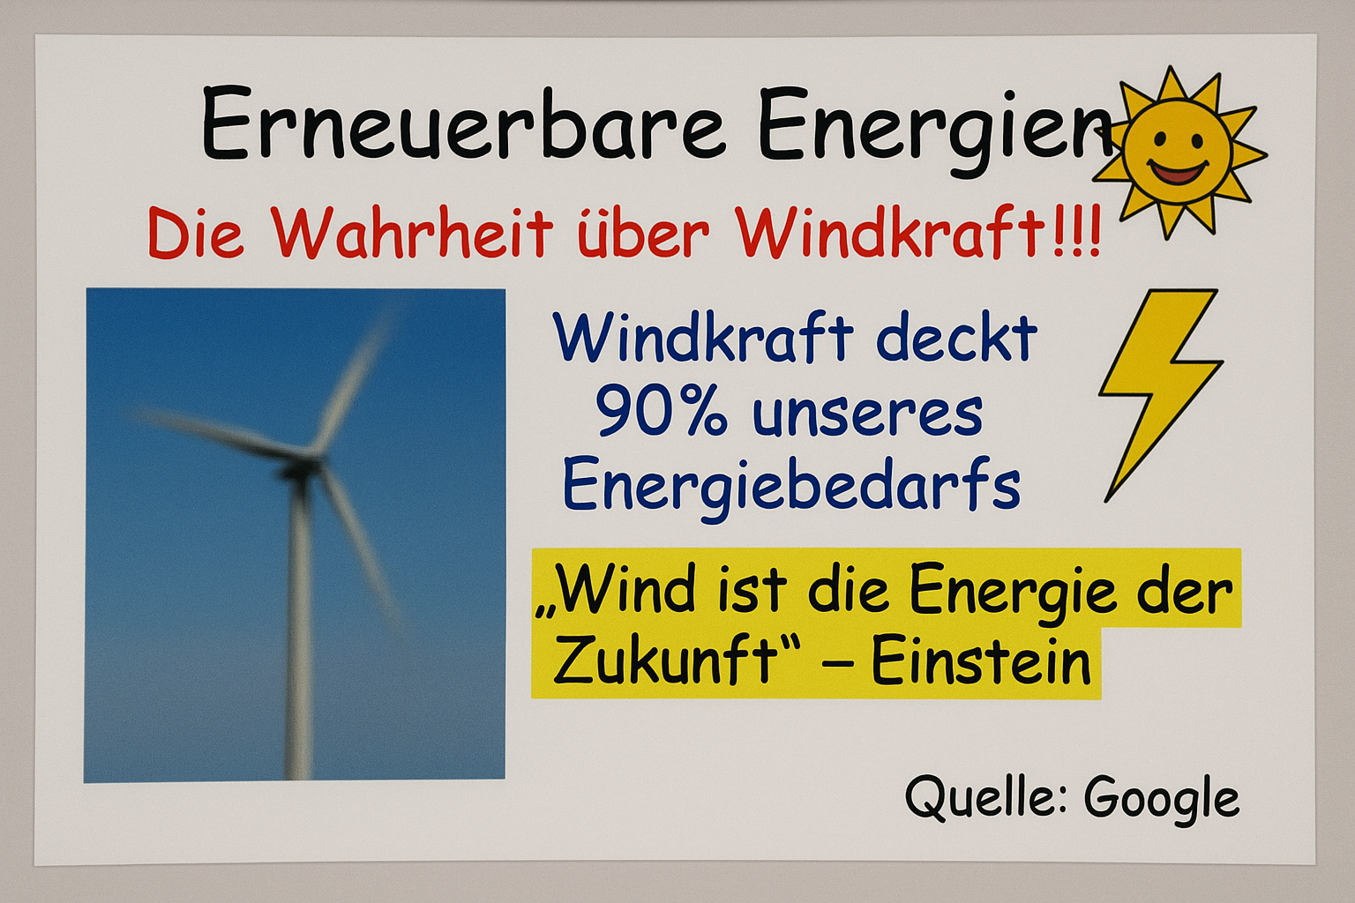
Notes:
Erstellt durch Sora mit dem Prompt: Create a screenshot of a PowerPoint slide titled "Erneuerbare Energien". The slide should appear poorly researched and visually unprofessional. Include the following elements:
– A sensational subtitle like "Die Wahrheit über Windkraft!!!"
– A blurry image of a wind turbine (stretched or pixelated)
– A statistic like "Windkraft deckt 90% unseres Energiebedarfs" without source
– A fake quote attributed to "Albert Einstein" (e.g. "Wind ist die Energie der Zukunft – Einstein")
– Random use of clipart (e.g. smiling sun, lightning bolt)
– Clashing fonts and colors (e.g. Comic Sans in red, yellow highlights)
– A footnote that says: "Quelle: Google"
The slide should look like it was made quickly by a student without verifying information. The layout should be chaotic, the content questionable.

Slide 2
Bildquelle: mit KI (SORA) erstellt
Prompt:
Create a screenshot of a PowerPoint slide titled "Erneuerbare Energien". The slide should appear poorly researched and visually unprofessional. Include the following elements:
– A sensational subtitle like "Die Wahrheit über Windkraft!!!"
– A blurry image of a wind turbine (stretched or pixelated)
– A statistic like "Windkraft deckt 90% unseres Energiebedarfs" without source
– A fake quote attributed to "Albert Einstein" (e.g. "Wind ist die Energie der Zukunft – Einstein")
– Random use of clipart (e.g. smiling sun, lightning bolt)
– Clashing fonts and colors (e.g. Comic Sans in red, yellow highlights)
– A footnote that says: "Quelle: Google"
The slide should look like it was made quickly by a student without verifying information. The layout should be chaotic, the content questionable.

